Slide 1
Homework 5a:
Installing Webservers
Apache (or Lighttpd)
MySQL
PHP
CGI and Dynamic Pages

Slide 2
Outline
Introductions
  Apache
  MySQL
  PHP
  Certificate Authentication
Installation
  Apache + MySQL + PHP
Administration
  Apache
  MySQL
Appendix
  Installing lighttpd
  CA

Slide 3
Apache
Official: http://www.apache.org/
Web httpd server that
  HTTP/1.1 compliant web server
  Modular design
  Can be customised by writing modules using Apache module API
  Freely available cross many platforms
Two main parts
  core
    Implement basic functions
  Modules
    Extend or override the functionality of the server
    Example:
      Access control, logging, CGI, proxy, cache control, PHP…

Slide 4
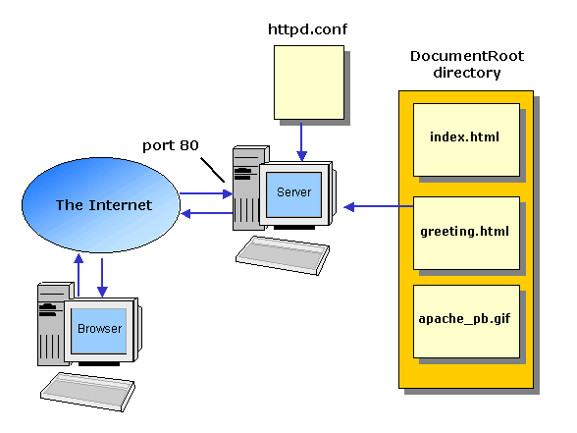
How Apache Works – request and response

Slide 5
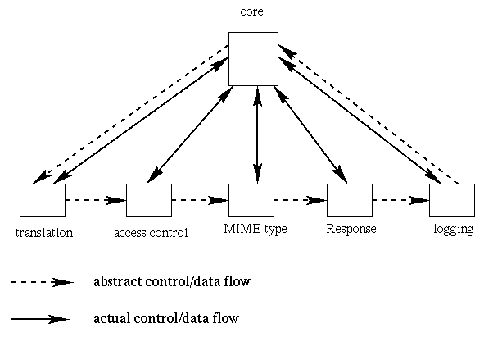
How Apache Works –
Each request-response
Apache breaks client request into several steps which are implemented as modules
Notes:
Translation:
filename translation:
Determine what information is wanted and where in storage it is
Access control
authentication and authorization
Is the user who they say they are, and Is the user authorized here?
MIME
text or image or sound or video or, …
Response
return to the client
Logging
logging the request

Slide 6
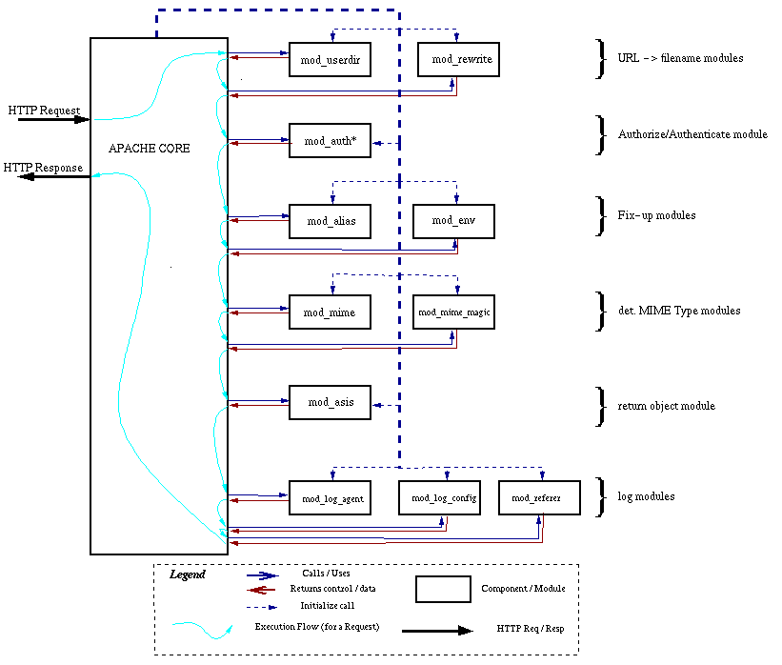
A p a c h e
D e t a i l

Slide 7
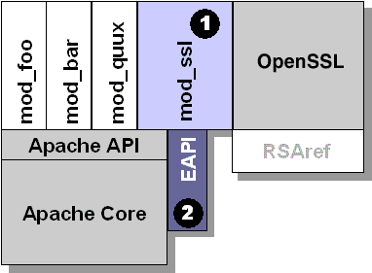
Apache with mod_ssl

Slide 8
MySQL (1)
Official Site: http://www.mysql.com
SQL (Structured Query Language)
  The most popular computer language used to create, modify, retrieve and manipulate data from relational database management systems.
  Introduction to SQL: http://www.1keydata.com/tw/sql/sql.html
A multithreaded, multi-user, SQL Database Management System.
MySQL is owned and sponsored by a Swedish company MySQL AB.

Slide 9
MySQL (2)
Characteristics:
  Writing in C/C++, tested by many compilers, portable to many systems.
  Providing APIs for C/C++, Java, Perl, PHP, Python, Ruby, Tcl, …etc.
  Supporting AIX, FreeBSD, HP-UX, Linux, Mac OS, Solaris, Windows, …etc.
  Multi-threaded kernel, supporting systems with multiple CPUs.
  Optimized algorithm for SQL Query.
  Multi-Language (coding) Supports.
  Lots of connecting method: TCP/IP, ODBC, JDBC, Unix domain socket.
  Free Software
  Popular for web applications

Slide 10
PHP
PHP: Hypertext Preprocessor
  A widely-used Open Source general-purpose scripting language.
  Originally designed to create dynamic web pages, PHP's principal focus is server-side scripting.
  PHP scripts can be embedded into HTML.
  The LAMP architecture has become popular in the Web industry as a way of deploying inexpensive, reliable, scalable, secure web applications.
    PHP is commonly used as the P in this bundle alongside Linux, Apache and MySQL.
    FAMP replaces Linux with FreeBSD, WAMP replaces Linux with Windows.
Notes:
PHP http://en.wikipedia.org/wiki/Php
Manual http://www.php.net/

Slide 11
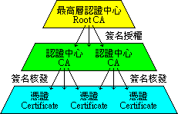
Certificate Authority (1)
Certificate
  憑證的原文是 Certificate ，是附上所有人 (owner) 的資料（公司名稱、伺服器名稱、個人真實姓名、連絡 E-mail 、通訊地址等資料），後面加上數位簽名的 Public Key 。憑證上會附有幾個數位簽名，代表這些簽名的人，確認過這個 Public Key 的所有人，和憑證上所載的資料相符，沒有假造。
  在 X.509 中，最下層每一個合格的憑證 (Certificate) 上，會有一個認證中心 (CA) 的簽名，表示這個認證中心 (CA) 檢查過，確認憑證上的所有者資料無誤。當程式碰到沒見過的憑證時，只要檢查憑證上認證中心 (CA) 的簽名無誤，即代表這個認證中心 (CA) 查核過這個憑證 (Certificate) ，憑證上的資料無誤。

Slide 12
Certificate Authority (2)
Certificate Authority
  認證中心的原文是 CA ，是 Certificate Authority 的縮寫，在微軟繁體中文 WINDOWS 上翻譯成憑證授權。認證中心是 X.509 的一環。認證中心也是一種憑證，上面附有認證中心本身的資料，但不是用來加解密，而是用來簽發憑證，證明憑證所有人和憑證上所載的資料無誤。
  每一個合格的認證中心 (CA) 上，會有一個管轄它的最高層認證中心 (Root CA) 的簽名，表示最高層認證中心授權給它，可以簽發別人的憑證。當程式碰到沒見過的憑證，憑證上簽名的認證中心 (CA) 也沒見過時，只要檢查認證中心上附的最高層認證中心 (Root CA) 的簽名無誤，即代表這個最高層認證中心 (Root CA) ，認為這個認證中心 (CA) 的憑證簽發過程很仔細，檢查資料很詳實，所以授權給它，准許它可以簽發憑證 (Certificate) 。所以這個認證中心 (CA) 簽發的憑證 (Certificate) ，憑證上的資料也沒有問題。
  Reference: http://www.imacat.idv.tw/tech/sslcerts.htm

Slide 13
Installation

Slide 14
In this exercise …
What to install
  We want to install Apache + PHP + MySQL + mod_ssl
Install sequence
  Install MySQL
  Install openssl and apache
  Install PHP
  Test PHP in apache

Slide 15
Install Sequence –
MySQL
Steps
  ＃cd/usr/ports/databases/mysql51-server/
  ＃make WITH_XCHARSET=all install clean
Add into rc.conf
  mysql_enable="YES"
Start up
  ＃/usr/local/etc/rc.d/mysql-server start

Slide 16
Install Sequence –
Openssl and Apache
Steps
  cd /usr/ports/security/openssl
  make install clean
  cd /usr/ports/lang/python
  Make options: WITHOUT_IPV6=yes
  cd /usr/ports/converters/libiconv
  Make options: WITH_EXTRA_PATCHES=yes
  cd /usr/ports/www/apache22/
  make WITH_CHARSET=utf8 WITH_XCHARSET=all WITH_MPM=worker WITH_THREADS=yes WITH_SUEXEC=yes WITH_BERKELEYDB=db4 WITH_STATIC_SUPPORT=yes WITH_ALL_STATIC_MODULES=yes install clean
Add into /etc/rc.conf
  apache22_enable=“YES"
Start up
  /usr/local/etc/rc.d/apache22 start

Slide 17
Install Sequence –
PHP
Steps
  ＃cd /usr/ports/lang/php5
  ＃make install clean
    Remenber to choose Apache module
Install php5-extensions
  ＃cd /usr/ports/lang/php5-extensions
  ＃make install clean
    Choose what you need

Slide 18
Install Sequence – test PHP in apache (1)
Edit httpd.conf to support php
  % cd /usr/loca/apache/conf
  % mkdir /www ; mkdir /www/data
  % Edit httpd.conf
<IfModule mime_module>
…
AddType application/x-httpd-php .php .phtml .php5
AddType application/x-httpd-php-source .phps
…
</IfModule>
ServerName sabsd.cs.nctu.edu.tw
# DocumentRoot "/usr/local/www/apache22/data"
DocumentRoot "/www/data“
…
# <Directory "/usr/local/www/apache22/data ">
<Directory "/www/data">
<IfModule mod_dir.c>
DirectoryIndex index.php index.html index.htm
</IfModule>

Slide 19
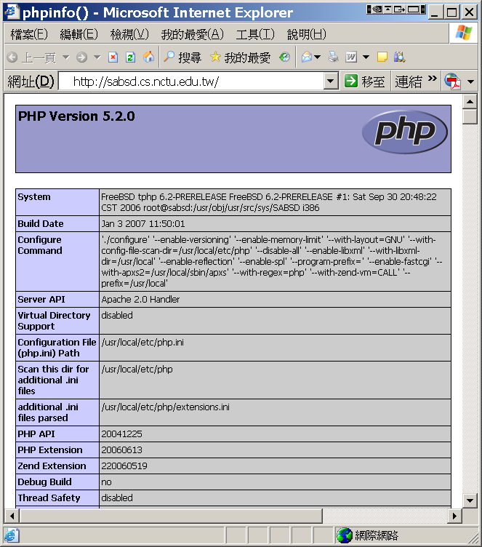
Install Sequence – test PHP in apache (2)
Restart httpd
  /usr/local/etc/rc.d/apache22 restart
Test PHP
  % Edit /www/data/index.php
<?
phpinfo();
?>

Slide 20
Administration

Slide 21
Apache configuration
Location
  The default location of apache (in ports) is /usr/local/etc/apache22
  Major configuration file: httpd.conf
    Other configuration files could be included. (setting in httpd.conf)
Two types
  Global configurations
    Global setting
    Server specific setting
    Virtual host setting
  Directory Configuration
    Local setting for certain directory

Slide 22
Apache configuration –
Global Configuration
Global setting
  ServerType standalone
  Timeout 300
  KeepAlive On
  KeepAliveRequests 100
  StartServers 5
Server configuration
  Port 80
  ServerAdmin chwong@sabsd.cs.nctu.edu.tw
  ServerName sabsd.cs.nctu.edu.tw
  DocumentRoot "/www/data"

Slide 23
Apache configuration –
Directory Configuration (1)
Configuration parameters
  Options
    All (turn on all options except multiview)
    ExecCGI (To allow executions of AddHandler)
    FollowSymLinks (access files outside this directory)
    Indexs (generate file-list for browsing)
    (when there is no DirectoryIndex files)
    MultiViews (multi-language support)
  AllowOverride
    All (Read .htaccess)
    None (ignoring .htaccess)
  Deny/Allow
    IP/DN (control access to this directory)
  Order
    Solve collision of deny and allow rules
<Directory "/www/data">
Options Indexes FollowSymLinks MultiViews
AllowOverride None
Order allow,deny
Allow from all
</Directory>

Slide 24
Apache configuration –
Directory Configuration (2)
# User home directories
#Include etc/apache22/extra/httpd-userdir.conf
UserDir public_html
UserDir disabled root toor daemon operator bin tty kmem games news man sshd bind proxy _pflogd _dhcp uucp pop www nobody mailnull smmsp
#
# Control access to UserDir directories. The following is an example
# for a site where these directories are restricted to read-only.
#
<Directory /home/*/public_html>
AllowOverride FileInfo AuthConfig Limit Indexes
Options MultiViews Indexes SymLinksIfOwnerMatch IncludesNoExec
<Limit GET POST OPTIONS>
Order allow,deny
Allow from all
</Limit>
<LimitExcept GET POST OPTIONS>
Order deny,allow
Deny from all
</LimitExcept>
</Directory>

Slide 25
Apache configuration –
Directory Configuration (3)
<IfModule alias_module>
Alias /icons/ "/usr/local/www/apache22/icons/"
<Directory "/usr/local/www/apache22/icons">
Options Indexes MultiViews
AllowOverride None
Order allow,deny
Allow from all
</Directory>
Alias /manual/ "/usr/local/apache/htdocs/manual/"
<Directory "/usr/local/apache/htdocs/manual">
Options Indexes FollowSymlinks MultiViews
AllowOverride None
Order allow,deny
Allow from all
</Directory>
</IfModule>

Slide 26
Apache configuration –
Virtual Host
Name-Base
  Singe IP, several hostnames
IP-Base
  several IPs
NameVirtualHost 140.113.51.24
<VirtualHost 140.113.51.24>
ServerName www.snmg.com.tw
DocumentRoot "/www"
</VirtualHost>
<VirtualHost 140.113.51.24>
ServerName mail.snmg.com.tw
DocumentRoot "/home/sywang"
</VirtualHost>
<VirtualHost 140.113.51.24>
ServerName csie.snmg.com.tw
Redirect / http://www.csie.nctu.edu.tw/
</VirtualHost>
<VirtualHost 140.113.50.33:80>
Port 80
ServerAdmin webmaster@sun3.csie.nctu.edu.tw
DocumentRoot /www/csie
ServerName sun3.csie.nctu.edu.tw
ErrorLog logs/csie-error_log
TransferLog logs/csie-access_log
</VirtualHost>
<VirtualHost 140.113.70.25:80>
Port 80
ServerAdmin webmaster@sun3.ee.nctu.edu.tw
DocumentRoot /www/ee
ServerName sun3.ee.nctu.edu.tw
ErrorLog logs/ee-error_log
TransferLog logs/ee-access_log
</VirtualHost>

Slide 27
Apache configuration –
.htaccess (1)
.htaccess
  Allow admin to use one file to control access to certain directory
Usage
  Modify httpd.conf
  Create .htaccess file
  Generate password database
  Test

Slide 28
Apache configuration –
.htaccess (2)
<Directory "/www/data/test1">
Options Indexes FollowSymLinks MultiViews ExecCGI
AllowOverride All
Order allow,deny
Allow from all
</Directory>
Example
  Modify httpd.conf
  Create .htaccess file
  Generate password file
chwong@sabsd [3:02pm] /www/data/test1> cat .htaccess
AuthName "SA-test1"
AuthType "Basic"
AuthUserFile “/www/data/test1/.htpasswd”
require valid-user
chwong@sabsd [2:58pm] /> /usr/local/apache/bin/htpasswd -c ./.htpasswd SA-user1
New password:
Re-type new password:
Adding password for user SA-user1

Slide 29
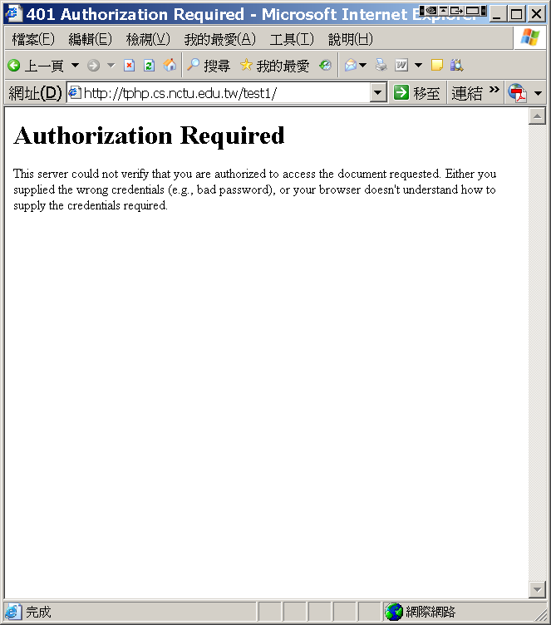
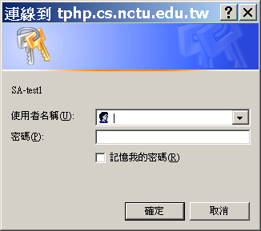
Apache configuration –
.htaccess (3)

Slide 30
Apache configuration – log
Rotate your log using newsyslog

Slide 31
Apache configuration –
Certificate Authority (1)
Flow
  Generate random seed
  Generate RootCA
    Generate private key of RootCA
    Fill the Request of Certificate.
    Sign the certificate itself.
  Generate certificate of Web Server
    Generate private key of Web Server
    Fill the Request of certificate
    Sign the certificate using RootCA
  Modify apache configuration ➔ restart apache

Slide 32
Apache configuration –
Certificate Authority (2)
  Generate random seed
    openssl rand -out rnd-file num
      Ex. openssl rand -out /etc/ssl/RootCA/private/.rnd 1024
    chmod go-rwx rnd-file
      Ex. chmod go-rwx /etc/ssl/RootCA/private/.rnd

Slide 33
Apache configuration –
Certificate Authority (3)
  Generate RootCA
    Generate private key of RootCA
      openssl genrsa -des3 -rand rnd-file -out rootca-key-file num
        % openssl genrsa -des3 -rand /etc/ssl/RootCA/private/.rnd \
        -out /etc/ssl/RootCA/private/rootca.key.pem 2048
        Note: phrase are asked (something like password)
      chmod go-rwx rootca-key-file
        % chmod go-rwx /etc/ssl/RootCA/private/rootca.key.pem

Slide 34
Apache configuration –
Certificate Authority (4)
  Generate RootCA
    Generate private key of RootCA
    Fill the Request of Certificate.
      openssl req -new -key rootca-key-file -out rootca-req-file
        % openssl req -new -key /etc/ssl/RootCA/private/rootca.key.pem \
        -out /etc/ssl/RootCA/private/rootca.req.pem
      chmod go-rwx rootca-req-file
        % chmod go-rwx /etc/ssl/RootCA/private/rootca.req.pem
Enter pass phrase for rootca-key-file:
Country Name (2 letter code) [AU]:TW
State or Province Name (full name) [Some-State]:Taiwan
Locality Name (eg, city) []:HsinChu
Organization Name (eg, company) [Internet Widgits Pty Ltd]:NCTU
Organizational Unit Name (eg, section) []:CS
Common Name (eg, YOUR name) []:sabsd.cs.nctu.edu.tw
Email Address []:chwong@cs.nctu.edu.tw
A challenge password []: (不需要密碼，直接 Enter)
An optional company name []: (直接 Enter)

Slide 35
Apache configuration –
Certificate Authority (5)
  Generate RootCA
    Generate private key of RootCA
    Fill the Request of Certificate.
    Sign the certificate itself.
      openssl x509 -req -days #_of_days -sha1 \
      -extfile path_of_openssl.cnf -extensions v3_ca \
      -signkey rootca-key-file -in rootca-req-file -out rootca-crt-file
        % openssl x509 -req -days 5109 -sha1 -extfile /etc/ssl/openssl.cnf -extensions v3_ca -signkey /etc/ssl/RootCA/private/rootca.key.pem -in /etc/ssl/RootCA/private/rootca.req.pem -out /etc/ssl/RootCA/private/rootca.crt.pem
      rm -f rootca-req-file
        %rm -f /etc/ssl/RootCA/private/rootca.req.pem
      chmod go-rwx rootca-crt-file
        %chmod go-rwx /etc/ssl/RootCA/private/rootca.crt.pem

Slide 36
Apache configuration –
Certificate Authority (6)
  Generate certificate of Web Server
    Generate private key of Web Server
      openssl genrsa -out host-key-file num
        %openssl genrsa -out /etc/ssl/sabsd/private/sabsd.key.pem 1024
      chmod go-rwx host-key-file
        %chmod go-rwx /etc/ssl/sabsd/private/sabsd.key.pem
    Fill the Request of certificate
      openssl req -new -key host-key-file -out host-req-file
        % openssl req -new -key /etc/ssl/sabsd/private/sabsd.key.pem -out /etc/ssl/sabsd/private/sabsd.req.pem
      chmod go-rwx host-req-file
        % chmod go-rwx /etc/ssl/sabsd/private/sabsd.req.pem

Slide 37
Apache configuration –
Certificate Authority (7)
  Generate certificate of Web Server
    Generate private key of Web Server
    Fill the Request of certificate
    Sign the certificate using RootCA
      Tramsmit host-req-file to Root CA, and do following steps in RootCA
      openssl x509 -req -days #_of_days -sha1 -extfile path_of_openssl.cnf \
      -extensions v3_ca -CA rootca-crt-file -CAkey rootca-key-file \
      -CAserial rootca-srl-file -CAcreateserial -in host-req-file -out host-crt-file
        % openssl x509 -req -days 361 -sha1 -extfile /etc/ssl/openssl.cnf -extensions v3_ca -CA /etc/ssl/RootCA/private/rootca.crt.pem -CAkey /etc/ssl/RootCA/private/rootca.key.pem -CAserial /etc/ssl/RootCA/private/rootca.srl -CAcreateserial -in /etc/ssl/sabsd/private/sabsd.req.pem -out /etc/ssl/sabsd/private/sabsd.crt.pem
      rm -f host-req-file ( in both RootCA and Web Server)
        % rm -f /etc/ssl/sabsd/private/sabsd.req.pem
      Transmit host-crt-file back to Web Server

Slide 38
Apache configuration –
Certificate Authority (8)
  Modify apache configuration ➔ restart apache
##
## SSL Virtual Host Context
##
<VirtualHost _default_:443>
# General setup for the virtual host
DocumentRoot /www/data
<Directory "/www/data">
Options Indexes FollowSymLinks
AllowOverride All
Order allow,deny
Allow from all
</Directory>
ServerName sabsd.cs.nctu.edu.tw:443
ServerAdmin chwong@sabsd.cs.nctu.edu.tw
ErrorLog /var/log/httpd/sabsd.cs-error.log
CustomLog /var/log/httpd/sabsd.cs-access.log common
SSLEngine on
SSLCipherSuite ALL:!ADH:!EXPORT56:RC4+RSA:+HIGH:+MEDIUM:+LOW:!SSLv2:+EXP:+eNULL
SSLCertificateFile /etc/ssl/sabsd/sabsd.crt.pem
SSLCertificateKeyFile /etc/ssl/sabsd/private/sabsd.key.pem

Slide 39
Administrating MySQL (1)
Config file
  Copy config file
    % cd /usr/local/share/mysql
    % sudo cp my-huge.cnf /etc/my.cnf
  Edit /etc/my.cnf
Start up
  Add into rc.conf
    mysql_enable="YES"
  ＃/usr/local/etc/rc.d/mysql-server start

Slide 40
Administrating MySQL (2)
Test
  % mysql –u root –p
    The initial password for root is empty
chwong@sabsd:/var/log> mysql -u root -p
Enter password:
Welcome to the MySQL monitor. Commands end with ; or \g.
Your MySQL connection id is 2 to server version: 4.1.7-log
Type 'help;' or '\h' for help. Type '\c' to clear the buffer.
mysql> show databases;
+----------+
| Database|
+----------+
| mysql |
| test |
+----------+
2 rows in set (0.27 sec)
mysql> exit
Bye

Slide 41
Administrating MySQL (3)
mysql> SELECT Host, User From mysql.user;
+-------------------------+------+
| Host | User |
+-------------------------+------+
| localhost | |
| localhost | root |
| sabsd.cs.nctu.edu.tw | |
| sabsd.cs.nctu.edu.tw | root |
+-------------------------+------+
Securing initial accounts
  Two initial accounts
    root
    anonymous
chwong@sabsd:~> mysql -u root -p
Enter password:
Welcome to the MySQL monitor. Commands end with ; or \g.
Your MySQL connection id is 4 to server version: 4.1.7-log
Type 'help;' or '\h' for help. Type '\c' to clear the buffer.
mysql> UPDATE mysql.user SET Password = PASSWORD(‘user123') WHERE User = '';
Query OK, 2 rows affected (0.26 sec)
Rows matched: 2 Changed: 2 Warnings: 0
mysql> UPDATE mysql.user SET Password = PASSWORD(‘root123') WHERE User = 'root';
Query OK, 2 rows affected (0.00 sec)
Rows matched: 2 Changed: 2 Warnings: 0
mysql> FLUSH PRIVILEGES;
Query OK, 0 rows affected (0.00 sec)

Slide 42
Administrating MySQL –
Using phpMyAdmin (1)
phpMyAdmin can manage a whole MySQL server as well as a single database.
Official Site: http://www.phpmyadmin.net/
Characteristics
  Browser-based, Supporting PHP5, MySQL 4.1 and 5.0, Open Source
Installation Steps
  Download latest version from official site
  Unzip the archived file.
  Read documents: Documentation.html
  copy config.sample.inc.php → config.inc.php
    Change auth type to http
    Remove configuration about Advanced Feature (something start with ‘pma’)
  Browse the phpMyAdmin, and login.

Slide 43
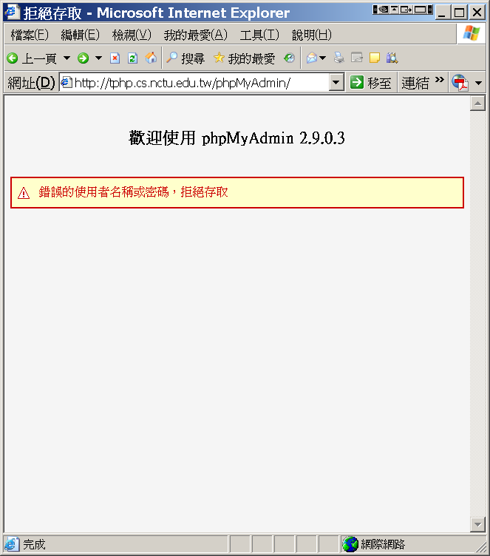
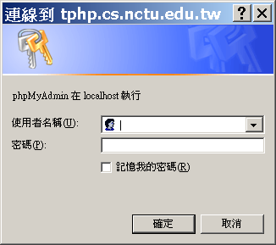
Administrating MySQL –
Using phpMyAdmin (2)

Slide 44
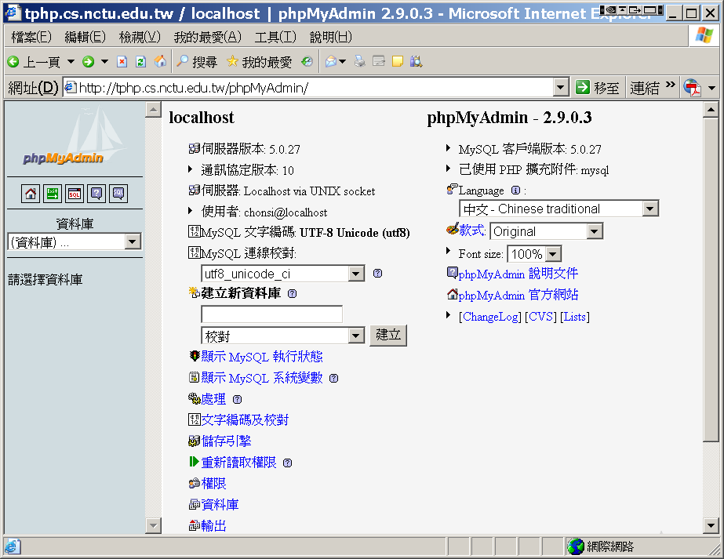
Administrating MySQL –
Using phpMyAdmin (3)

Slide 45
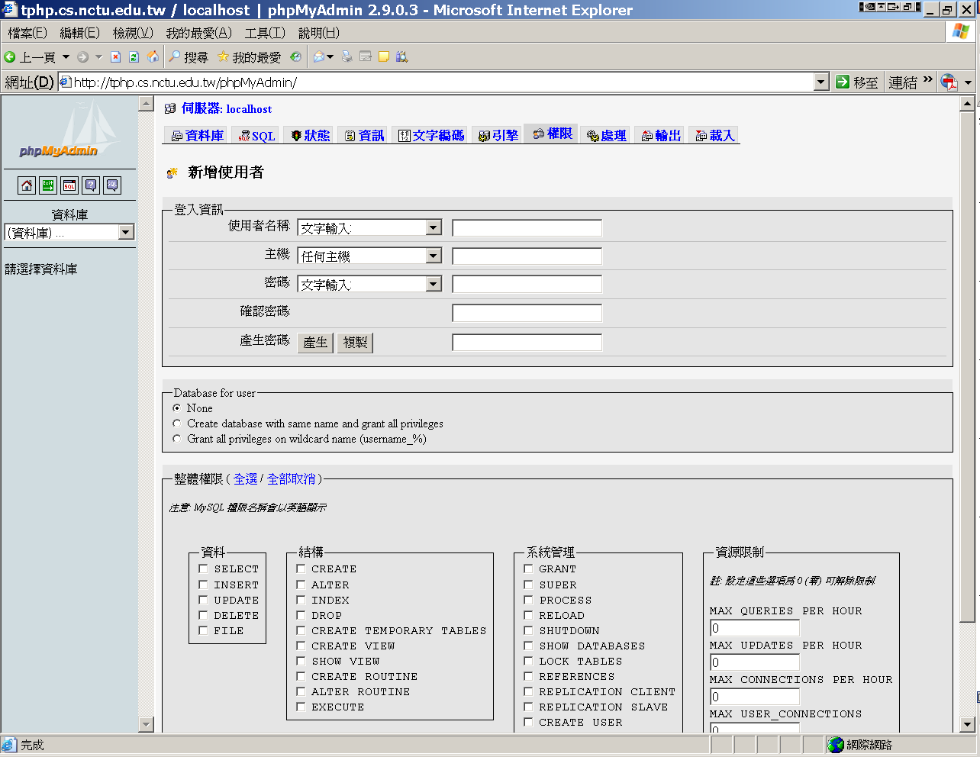
Administrating MySQL –
Using phpMyAdmin (4)
Create another user with limited privilege

Slide 46
Appendix: Installing lighttpd

Slide 47
Installing lighttpd (1)
Official: http://www.lighttpd.net/
安裝
  # cd /usr/ports/www/lighttpd
  # make install clean
Supporting PHP
  修改lighttpd的設定檔/usr/local/etc/lighttpd.conf
      將「“mod_fastcgi”,」前面的註解(#字號)刪除
      將
        fastcgi.server= ( “.php”=>
        ( "localhost" =>
        (
        "socket" => "/tmp/php-fastcgi.socket",
        "bin-path" => "/usr/local/bin/php-cgi"
        )
        )
        )
      這八行的註解刪除

Slide 48
Installing lighttpd (2)
SSL support
  #### SSL engine
  ssl.engine = “enable”
  ssl.pemfile = “/path/server.pem”
Virtual Hosting
  Simple Virtual-Hosting
    #simple-vhost.server-root = "/home/weigon/wwwroot/servers/"
    #simple-vhost.default-host = "grisu.home.kneschke.de"
    #simple-vhost.document-root = "/pages/“
  Enhanced Virtual-Hosting
    http://trac.lighttpd.net/trac/wiki/Docs%3AModEVhost
其餘可按需求更改設定

Slide 49
Installing lighttpd (3)
在/etc/rc.conf檔案中加入：
  lighttpd_enable="YES"
手動啟動
  /usr/local/etc/rc.d/lighttpd start

Slide 50
Appendix: CA

Slide 51
What is a CA ?
Certificate Authority (認證中心)
Trusted server which signs certificates
One private key and relative public key
Tree structure of X.509
  Root CA

Slide 52
What is a CA ? (c.2)
Root CA (最高層認證中心)
  Micro$oft 翻譯成「根目錄授權憑證」
  通常 Root CA 不會直接用來簽發憑證，而是授權給一些中間的認證中心，讓這些中間的認證中心來簽發憑證
  Root CA 自己幫自己簽名
    沒有再上層可以為他簽名
  認可最高層認證中心
    經由 secure channel 安裝 Root CA 的憑證
  Root CA 只能由一些著名可靠的公司來擔任
    無法再向上查驗，所以不可隨便加進系統信任的 Root CA

Slide 53
What is a CA ? (c.3)
Tree structure of CA
  每個合格的 CA，都會有一個管轄它的最高層 CA 的簽名，表示 Root CA 授權給它，可以簽發別人的憑證
  當程式碰到沒見過的憑證，憑證上簽名的 CA 也沒見過時，只要檢查 Root CA 的簽名無誤，就接受這個憑證
Cost of certificate
  HiTrust : NT $30,000 / per year / per host
  Myself : NT $0

Slide 54
Certificate
電子憑證 / 公開金鑰憑證 / 網路身份證
A certificate is issued by a CA X
A certificate of a user A consists:
  The name of the issuer CA X
  His/her public key KU_{A}
  The signature Sig(KR_{X}, A, KU_{A}) by the CA X
  The expiration date
  Applications
    Encryption / Signature

Slide 55
Certificate (c.1)
CA X:
(3) Generate
Sig(KR_{X}, Alice, KU_{A}, T)
Alice:
Generate
KU_{A,}, KR_{A}
(2) Alice, KU_{A}, ID proof
(4) Sig(KR_{X}, Alice, KU_{A}, T)
Cert_{A,X}=[Alice, KU_{A}, Sig(KR_{X}, Alice, KU_{A})]
Note: CA does not know KR_{A}

Slide 56
Certificate (c.2)
Guarantee of CA and certificate
  Guarantee the public key is of someone
  Someone is not guaranteed to be safe
Security of transmitting DATA
  Transmit session key first
    Public crypto system
  Transmit DATA by session key
    Symmetric crypto system

